Slide 1

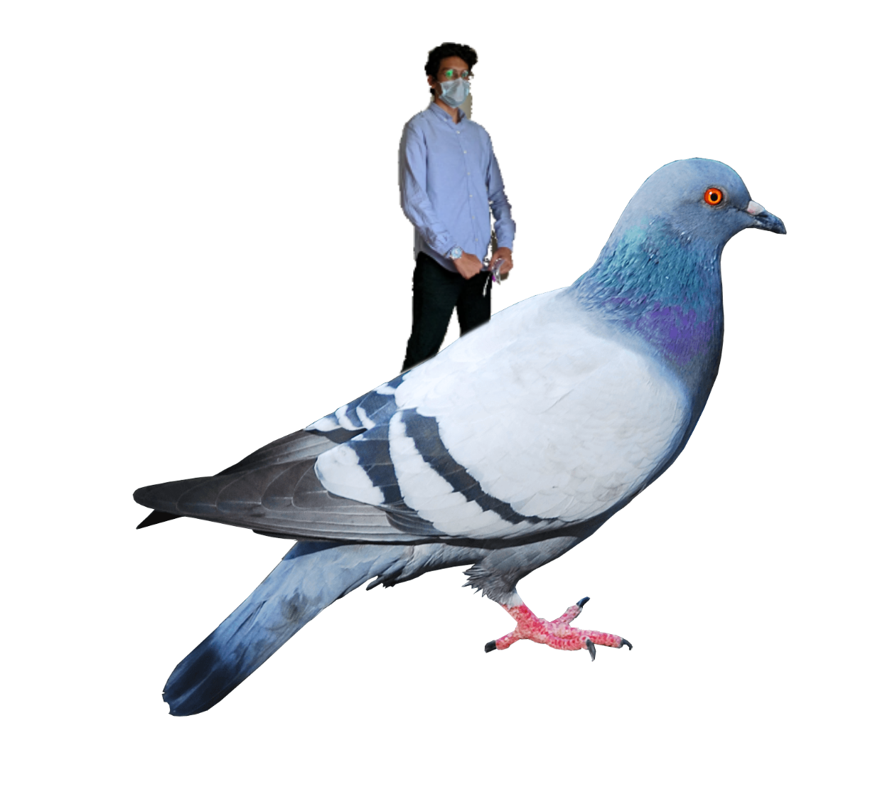
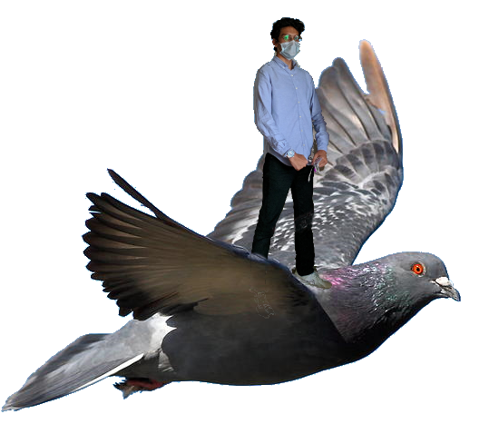

Kabootars and Ladders:
Why did we do this? (BTS)
Sudais, Zain and Murtaza’s DSA Project

Slide 2
Challenges
#Compiling main_menu.py with game.py
if user clicks “Player 3”:
write_to_config_file()
exit_rest_of_the_pygame_material()
# run main_game_files
game()
# game will automatically extract data from config file
#Compiling main_menu.py with game.py
if user clicks “Player 3”:
exit_rest_of_the_pygame_material()
# run main_game_files
game(3)
Logistic
  Lack of a clear deadline
  Adjusting to eachother’s styles
  Lack of standardization (e.g. naming schemes, OOP or functional etc.)
  Lost visual schemes
Technical challenges
  Making sure data can effectively be carried across files
    Config files (config parser)
    Passing variables into main
    …
  Stacking function calls as intended
    pygame windows not closing as expected
  Global variables = messes

Slide 3
#Compiling main_menu.py with game.py
if user clicks “Player 3”:
game(3)
exit rest of the
while n < S:
S = ((S-n-1)//2) + S - n
return (S)
#Compiling main_menu.py with game.py
if user clicks “Player 3”:
exit_rest_of_the_pygame_material()
# run main_game_files
game(3)
#Compiling main_menu.py with game.py
if user clicks “Player 3”:
write_to_config_file()
exit_rest_of_the_pygame_material()
# run main_game_files
game()
# game will automatically extract data from config file

Slide 4
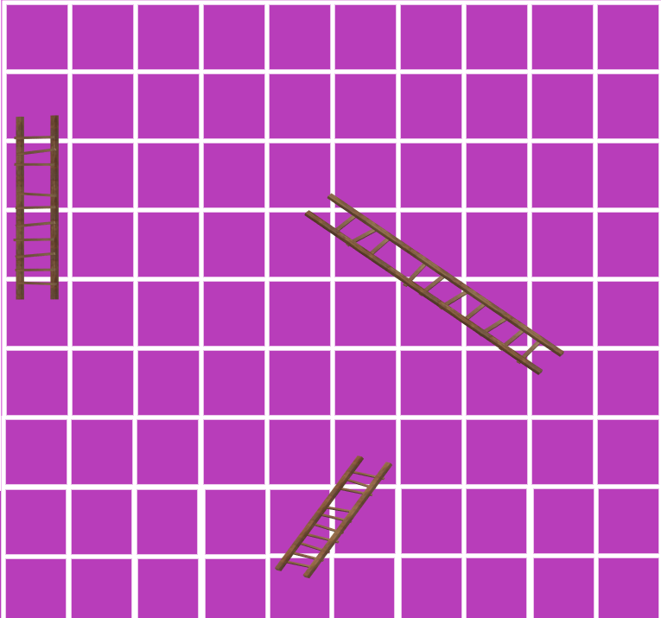


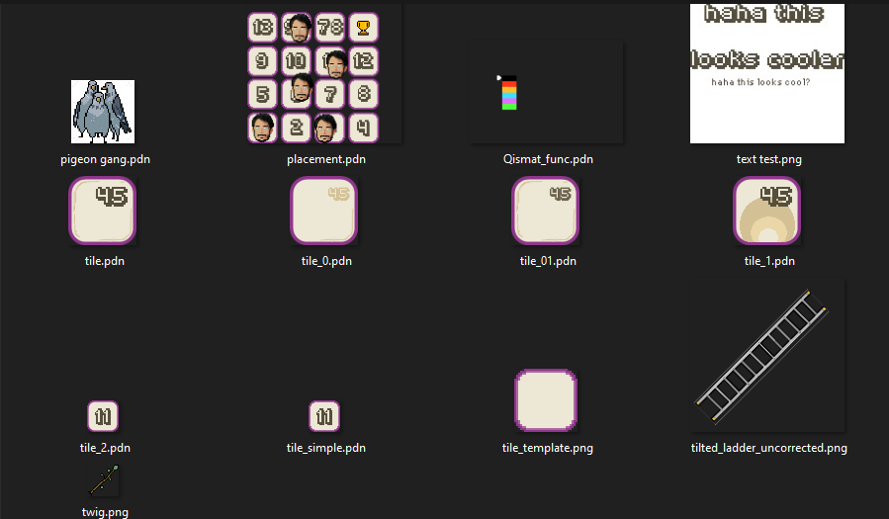
Main ideas that we tested and tried
Using pixel-art

Slide 5
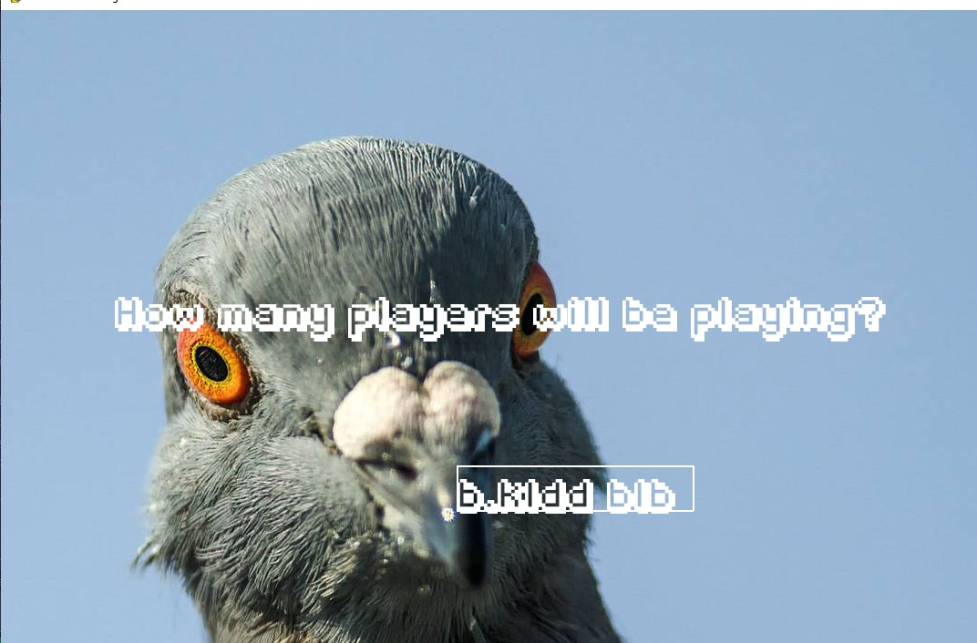
Main ideas that we tested and tried
text-based input for players
Using pixel-art

Slide 6
Main ideas that we tested and tried
Using pixel-art
text-based input for players

Slide 7
Improvements
Snakes and ladders’ ideal case calculator
  Game tells you in real-time who’s most likely to win
Infinite number of players (text-based input fixed)
Consistent team-code + standardisation
Using pixel-art
  Maybe doing it with python

